Slide 1

RETRO NIGHT HOUSE
ADRENALINE INSIDE

Slide 2
RESOURCES USED
This wholesome portable game possess the power of ATmega-328P and runs on Arduino Nano microcontroller board.
Jumper Cables for wiring connections of the RN-HOUSE.
10 LED’s & switches for gaming visual operations.
Ten 240 ohm resistors used so that current is limited.
This game can be powered from any 5V power source.
A box where all these components make their home for action packed gaming.

Slide 3
CONCEPT
Nowadays, gaming has been limited to mobile phones and console based devices.
RETRO NIGHT HOUSE brings back the old memories in the time back then when we played arcade games, chilled with our friends, competed with them and laughed together.
This arcade game is a future packed game where you can attach it to any of your devices to give it a power source. It is made as much as portable as your power banks.

Slide 4
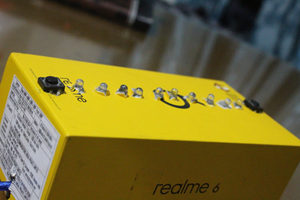
THE RETRO NIGHT HOUSE
This game has a simple rule:
In the running strip of the lights, you have to take your focus to the next level because here you win by capturing the pause of the light at the starting point of your opponent. If you lose, the lights will run again in a challenging way

Slide 5
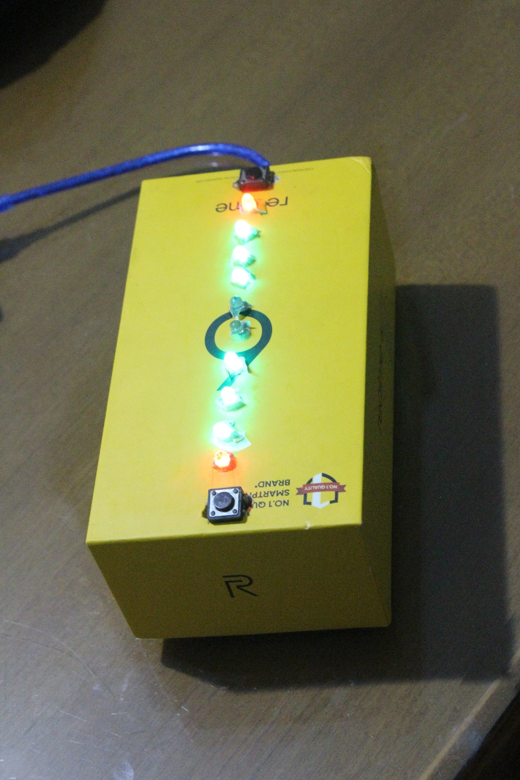
STAGING OF THE PROJECT
Wiring of the project
Compilation of code
Assembly & Testing

Slide 6
WORKING OF THE PROJECT

Slide 7
BOOT SCREEN
LED’S USED
FUNCTION
The LED’s blink on the boot of the game
The blink delay is 800 ms
It shows up the screen when we boot up the game.
If you want to start the game, press either of the buttons at the corners of the LED’s

Slide 8
HOW TO PLAY THE GAME?
While in the boot menu, either of the players has to hold any corner button for a second.
The main game starts and the LED’s lights blink back and forth with a delay of 22 ms.
Either of the players has to press their respective button when the opposite LED illuminates.
The player to reach the score of 5 wins.
The LED blinks whenever a player scores a point and it blinks according to the player’s score.
At the end of the game, the LED’s illuminate for the amount of score earned by each player by his side.
The game restarts after 10 seconds.

Slide 9
WHAT TO EXPECT IN THE NEXT UPDATE?
When plugged in to your device , scores will be shown on your device(Windows/Mac/Android/iOS)
A new LCD screen for better game visuals and detail.
In-built battery for enhanced portability.

Slide 10
THANK YOU
-ARYAN SAHU(2019BTCS018)
-CHARUDATTA PADHYE(2019BTCS024)

